Slide 1

CHOPPED EC523 FINAL PROJECT
Christopher Chan, Aya Kassem, Leanorine Lorenzana-Garcia, and Christian So
December 11, 2023
Notes:
Christian
Hi everyone, this is our EC523 FInal Project, called Chopped, inspired by the cooking cooking show Chopped. This was our original project name but a lot has changed since then, but it is still relevant as we still working with food. I’m Christian …<team members>.
Presentation References:
[1] https://openai.com/research/clip
[2] https://arxiv.org/abs/2212.06138
[3] https://arxiv.org/abs/1608.06993
[4] https://arxiv.org/abs/1610.02357

Slide 2
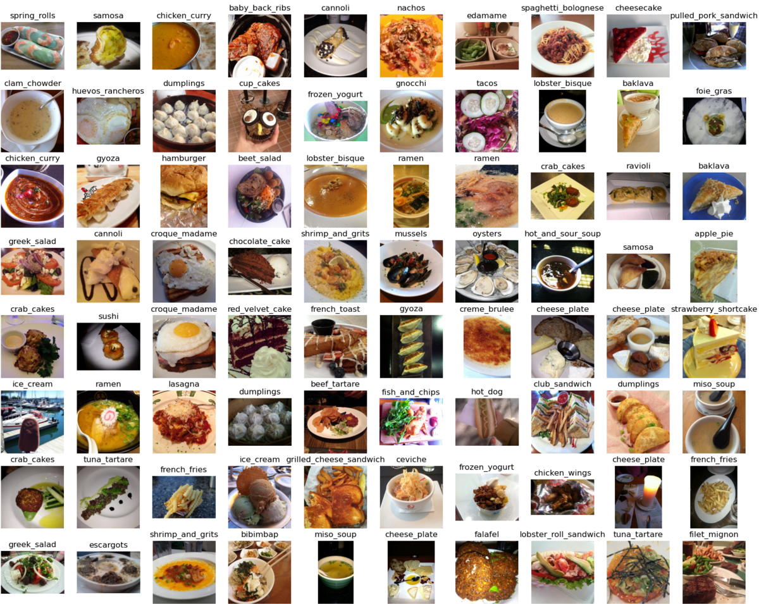
Introduction
Motivation
Previous Works
Task
Methods
Transfer Learning
Fine-Tuned CLIP
Data
Results
Analysis
Q&A
Outline
Contribution Key
• Chris Chan • Leanorine Lorenzana-Garcia
• Aya Kassem • Christian So
Food-101 with Labels
••••
Boston University EC523 Deep Learning
Notes:
Christian
So, a quick outline of what we will be talking about today: We will first introduce the motivation, previous works, and ultimate task of our project. Then, how did we accomplish this task through our methods. And then we will take a look at our final results, and analyze them, and then answer any questions you may have.
A quick note, our contribution will be denoted with these colored dots on your bottom right hand corner of the slides.
So, each topic and colored dot will be correlated with who contributed to which part of the project. So, let’s get right into it.
Purple Lea
Blue Chris
Green Aya
Orange Christian

Slide 3
Major food image datasets are westernized. More exotic food datasets are sparse.
Motivation
Training classifiers on sparse exotic food datasets results in poor accuracy in classifying exotic foods. Where’s my Filipino Food😭
Notes:
Lea

Slide 4
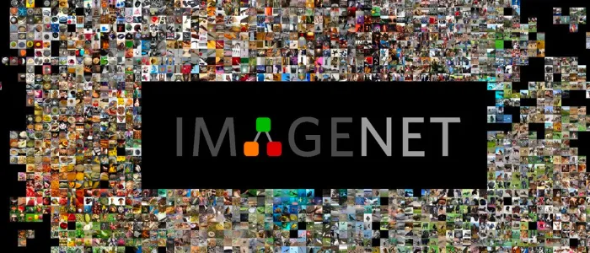
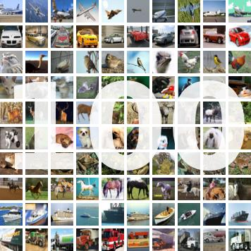

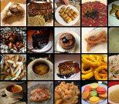

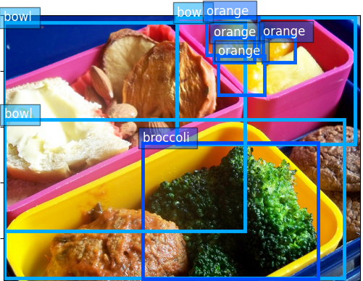
Largest Image Datasets
Motivation
Unlike other datasets, Food-101 allows machine learning models to develop a broader understanding of global cuisine, enabling them to recognize and classify not only familiar dishes but also exotic and culturally diverse foods accurately.
ImageNet
Food101
COCO
CIFAR-100
Common Objects in Context
ImageNet is best known for its 1,000 object categories, with a subset of 46 food-related categories. Food categories are either westernized-foods fruits, or vegetables.
Food-101 dataset contains 101 different food categories, each representing a specific type of dish or food item. Includes a wide variety of items from more western dishes like pizza and hamburgers to more exotic dishes like peking duck and huevos rancheros.
The COCO dataset is comprised of 80 object categories, with a subset of 10 food-related categories. Images can contain multiple instances of the same object category, and objects may overlap each other making it an optimal dataset for object detection, instance segmentation, and image captioning.
CIFAR-100 is an extension of the CIFAR-10 dataset, designed to be more challenging and diverse. CIFAR-100 is organized into a hierarchical structure with 20 superclasses, each containing 5 subclasses. However, it only contains 5 basic food items, not whole dishes.
Boston University EC523 Deep Learning
•
Notes:
Lea
ImageNet:
ImageNet is a large-scale image database and benchmark dataset that has played a significant role in advancing the field of computer vision and machine learning.
It has 1000 object classes and contains 1,281,167 training images, 50,000 validation images and 100,000 test images.
only 46 of these are food-related and mostly western
ImageNet is often used for transfer learning.
Researchers train deep neural networks on the large ImageNet dataset and then fine-tune those pre-trained models for specific image recognition tasks with smaller datasets.
Many state-of-the-art models such as CLIP, are pre trained using ImageNet
Food-101:
There are approximately 101,000 images in the dataset, with each category containing around 1,000 images.
This large number of images allows for robust training and evaluation of machine learning models.
Image variety from more western foods to more exotic foods
Images may exhibit some variations in terms of image quality and background clutter
The dataset is divided into a training set and test set with no overlapping images between sets
It's a valuable resource for researchers and developers working on applications related to food image analysis, menu recommendation, calorie tracking, and more.
COCO:
The COCO (Common Objects in Context) dataset is a widely used benchmark dataset in computer vision and object recognition research.
It is designed to facilitate the training and evaluation of machine learning models for various computer vision tasks, particularly those related to object detection, segmentation, and captioning.
It has been used in various competitions, challenges, and research projects to develop and evaluate models for tasks such as object detection, semantic segmentation, and image captioning.
most recent versions of the dataset contain around 118,000 images for training and 5,000 images for validation.
CIFAR-100:
The CIFAR-100 dataset is a commonly used dataset in the field of machine learning and computer vision.
The dataset consists of 60,000 color images, with 600 images per class.
These images are divided into two equal parts: 50,000 images for training and 10,000 images for testing.
CIFAR-100 images are more complex and can be more challenging to classify correctly.
Researchers use it to assess the robustness and generalization abilities of their models when dealing with a larger and more diverse set of object categories.
It is widely used for image classification and transfer learning tasks.

Slide 5
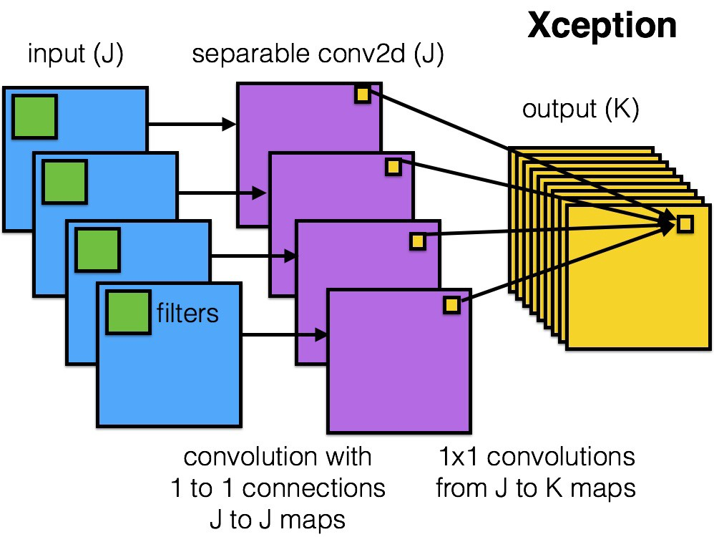
Previous Works
Literature
DenseNet - 201
DenseNet - 201 is a Convolutional Neural Network model that is 201 layers deep. In a Dense block, each layer is connected to every other layer of the block. This facilitates the gradient flow throughout the block and helps avoid a vanishing gradient problem.
XCeption
Xception is a deep convolutional neural network architecture that is known for its use of depth-wise separable convolutions.
It splits the convolution operation into two separate operations: depthwise convolution and pointwise convolution, that are then interleaved with skip connections.
Boston University EC523 Deep Learning
••
Notes:
Aya
Previous works for image classifiers
DenseNet - 201 :
201 Indicates the Number of layers
DenseNet is a deep neural network architecture design to address issues related to vanishing gradients and promote feature reuse
Dense Blocks:
feature maps from all previous layers in the block are concatenated and passed as input to the current layer, helping with information flow, encouraging feature reuse, and reduces the vanishing gradient problem.
Transition Blocks:
Between dense blocks, transition blocks are used to reduce the spatial dimensions of feature maps and control the number of feature maps.
Bottleneck Layers:
bottleneck layers consist of a 1x1 convolution layer followed by a 3x3 convolution layer.
The 1x1 convolution layer reduces the number of feature maps before the 3x3 convolution, which helps in reducing computational complexity.
Growth Rate:
DenseNet-201 typically uses a growth rate of 32, meaning that each layer in a dense block generates 32 new feature maps.
Global Average Pooling:
GAP calculates the average value of each feature map and produces a fixed-size feature vector, which is then followed by a softmax layer for classification.
XCeption:
Xception’s architecture uses of depth-wise separable convolutions
it splits the convolution operation into two separate operations: depthwise convolution and pointwise convolution, that are then interleaved with skip connections.
It is pre-trained on ImageNet
Due to its modular structure it can be scaled and adapted for different tasks.
Two Separate Operations:
Depthwise Convolution:
Applies a separate convolution operation to each channel of the input.
each channel is convolved separately with a kernel.
Pointwise Convolution:
A 1x1 convolution is applied to the output of the depthwise convolution to combine information from different channels.
Skip Connections:
Includes skip connections to facilitate the flow of gradients during training and help mitigate the vanishing gradient problem.
Allows information to bypass certain layers and directly flow to deeper layers in the network.
Model mostly used for:
image classification, object detection, and image segmentation

Slide 6
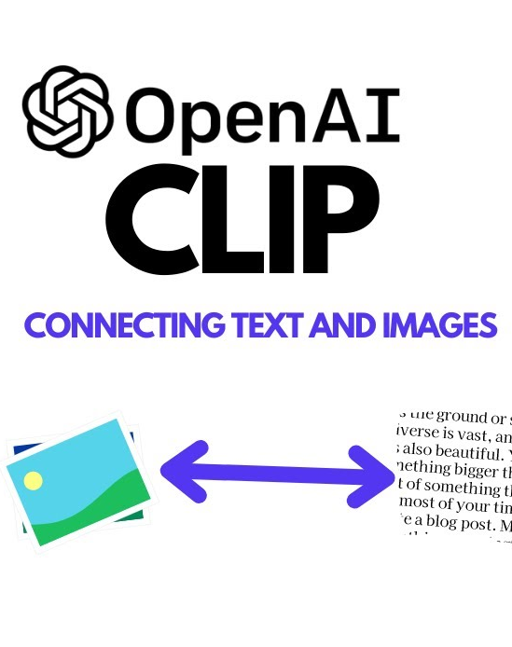
Improve Classification Accuracy on Exotic Sparse Food Datasets
Task
Transfer Learning by Fine-Tuning CLIP
Classification for exotic foods is difficult:
scarcity and imbalance data
high variability and visual ambiguity of food
cultural diversity, lack of standardization
Complex, nuanced features/labels inherent
in these foods
Boston University EC523 Deep Learning
••
Notes:
Christian
With the motivation the previous works in mind, we asked ourselves, how can we improve the classification accuracy on sparse exotic food datasets? This challenge has many difficulties and nuances to it, however.
There could also be high variability and visual ambiguity amongst these sparse datasets as most of these exotic foods do not have quality standardized photos of them like ImageNet or Cifar-100 does. Most of these images are pulled from many different resources to even create these data sets, which we’ll see later I did. Lastly, many of these exotic foods have different names across cultures. A fruit in the US might have a different name in Asia and vice versa, making the classification task more nuanced. To accomplish this task,
Apple is apple in the US and Mansanas in the philippines
For example, the datasets that are sparse will most likely be imbalance where we have one image for one class and then 10 images for another class causing the distribution to be skewed and not representative of the class features.

Slide 7
Transfer Learning by Fine-Tuning CLIP
Task
Improve Classification Accuracy on Exotic Sparse Food Datasets
Classification for exotic foods is difficult:
scarcity and imbalance data
high variability and visual ambiguity of food
cultural diversity, lack of standardization
Complex, nuanced features/labels inherent
in these foods
Boston University EC523 Deep Learning
••
Notes:
Christian
my team and I propose to implement transfer learning by Fine-tuning OpenAI’s Contrastive Language Image Pretraining Model, otherwise known as CLIP. This transformer model is already pretrained on ImageNET, and we hope to exploit its pretraining knowledge to help us create a strong classifier on sparse exotic food data sets. Although we want to leverage both image and natural language self-supervision in our backbone we still want our method to be language and culture agnostic, hence we will be fine tuning with images.

Slide 8
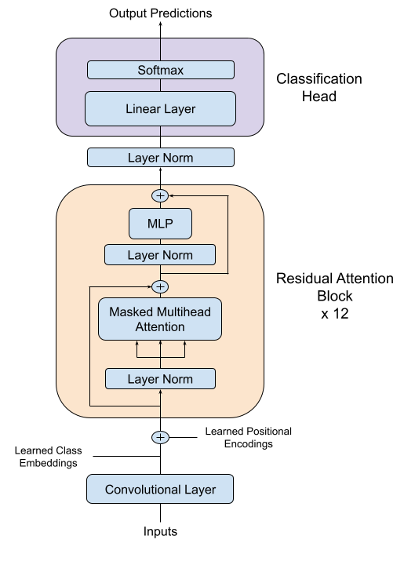
Fine Tuning
CLIP
Methods
Linear Probing
Precompute image embeddings to speed up computation and train a single linear layer
Unfreezing Layers
Found that unfreezing all the layer norms allows for stable optimization
Boston University EC523 Deep Learning
••
Notes:
Chris

Slide 9
Fine Tuning
CLIP
Methods
Frozen
🥶
Linear Probing
Precompute image embeddings to speed up computation and train a single linear layer
Unfreezing Layers
Found that unfreezing all the layer norms allows for stable optimization
Boston University EC523 Deep Learning
••
Notes:
Chris

Slide 10
Fine Tuning
CLIP
Methods
Frozen
Linear Probing
Precompute image embeddings to speed up computation and train a single linear layer
Frozen
Unfreezing Layers
Found that unfreezing all the layer norms allows for stable optimization
Frozen
Boston University EC523 Deep Learning
••
Notes:
Chris

Slide 11
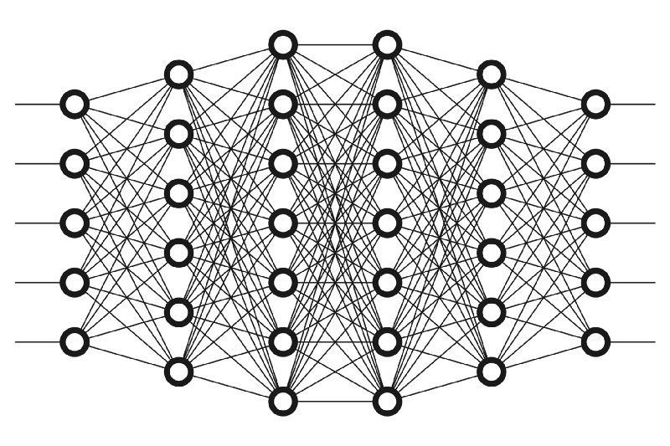
Layer Learning Rate Decay
Methods
lr = 0.0059
lr = 0.0066
lr = 0.0073
lr = 0.0081
lr = 0.009
lr = 0.01
x 0.9
x 0.9
x 0.9
x 0.9
x 0.9
Layer Norm Layers have Learning Rate Decay
Preserve CLIP’s pretrained knowledge on ImageNET and learn the new features from the new images from new sparse datasets
Geometric decay -> essentially “freezes” beginning layers that have already learned significant features (Example above shows a geometric layer learning rate decay value of 0.9)
Boston University EC523 Deep Learning
••
Notes:
Christian
To get a happy Medium of the two , Layer Learning Rate Decay LLRD.
We utilize a geometric layer learning rate decay where each layer norm from layers 7-11 are unfrozen and assigned a new unique learning rate decay for optimization. By fine tuning this hyper-parameter, it makes CLIP’s early layers act as if they are frozen, being insensitive to new features due to the small LLRD but still learning something new. We do this because those early layers already learned significant features that we want to leverage for the new unseen sparse dataset.
To combine the attributes of learning the classification head and maintain the pretrained knowledge of CLIP, while updating and finetuning the CLIP’s knowledge that Chris mentioned, we utilize Layer Learning Rate Decay (LLRD) to balance between allowing CLIP to learn new features and maintain some of its pretrained knowledge.
Potential Effects of Fine-Tuning LayerNorm:
Improved Adaptation to Specific Data: Fine-tuning LayerNorm can help the model better adapt to the specific characteristics of a new dataset, especially if the new data has a different distribution than the original training data.
Enhanced Generalization: By fine-tuning these normalization parameters, the model might generalize better to unseen data, as it adjusts the internal normalization to better suit the specific task at hand.
Stabilizing Fine-Tuning Process: Adjusting the LayerNorm parameters can also contribute to the stability of the fine-tuning process itself, especially in deep networks where normalization plays a crucial role in maintaining healthy gradients.
Balancing Feature Contributions: Fine-tuning LayerNorm can help in re-balancing the contributions of different features in the model’s representations, which might be particularly useful if the task or the data domain has shifted.

Slide 12
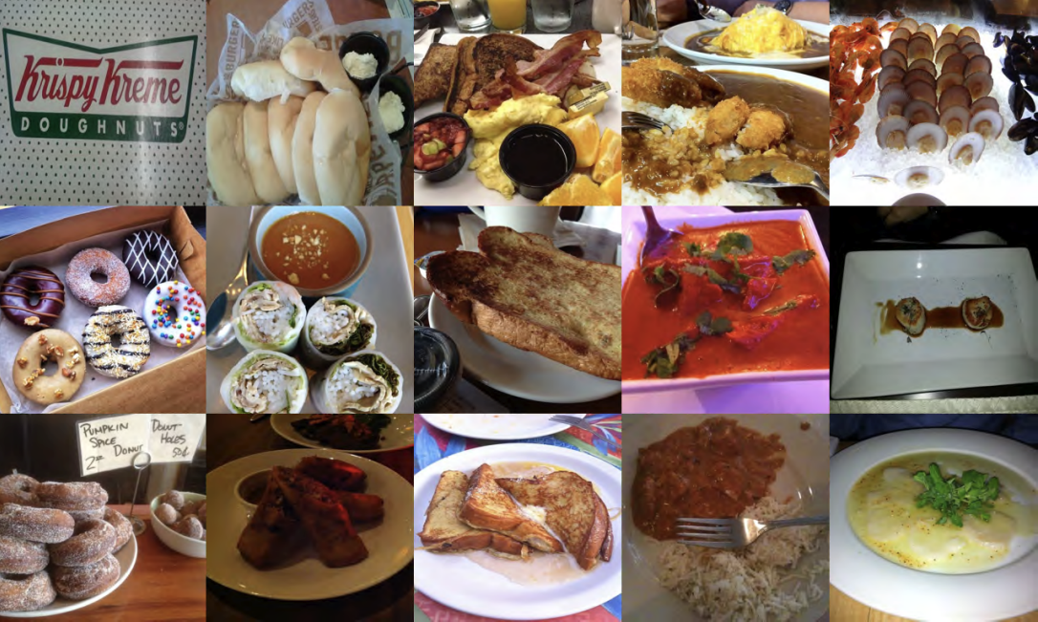
Training and Testing
Data
Food-101 Data Set
Varying the amount of data allows us to:
Mimic sparse datasets
Minimal amount of images
Less exposure to exotic foods
Assess if the model is overfitting
Establish performance benchmarks
1%
7 images/category
60%
450 images/category
10%
75 images/category
70%
525 images/category
20%
150 images/category
80%
600 images/category
30%
225 images/category
90%
675 images/category
40%
300 images/category
100%
750 images/category
50%
375 images/category
test
250 images/category
Boston University EC523 Deep Learning
•
Notes:
Lea
Unlike other datasets, Food-101 allows machine learning models to develop a broader understanding of global cuisine, enabling them to recognize and classify not only familiar dishes but also exotic and culturally diverse foods accurately.

Slide 13
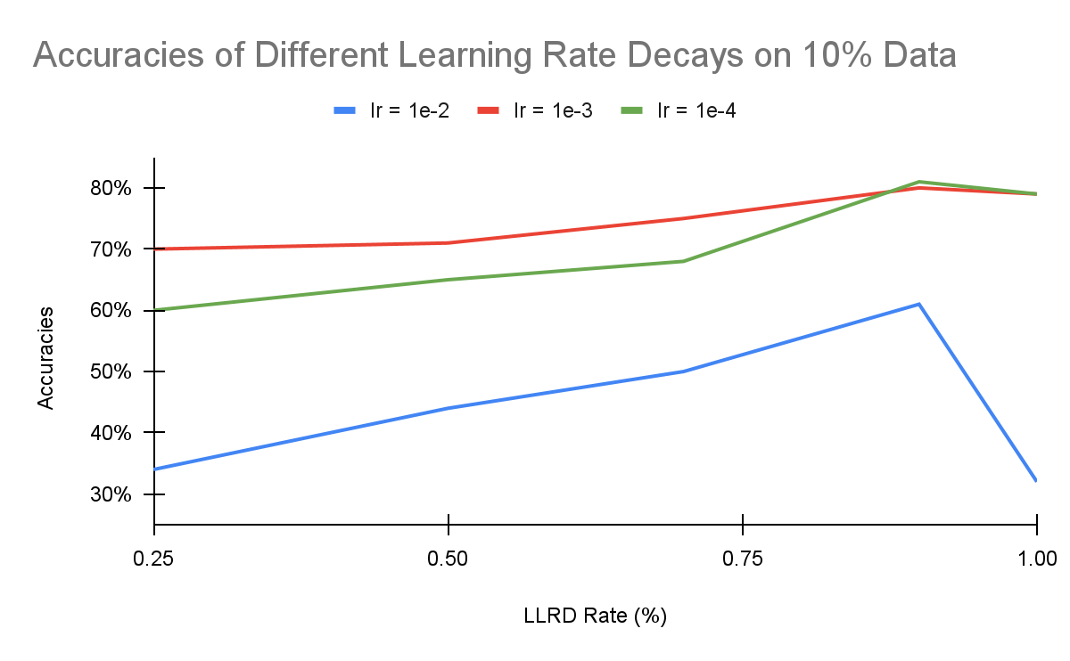
Results
Fine Tuning LLRD
Layers (Layer Norms) Unfrozen:
7 - 11
LLRD = 1 : Constant Learning Rate
Constant Learning rate causes decreased performance -> forgetting
Faster decay -> Lower accuracies and model does not fine-tune well
Figure 2: Accuracy Curves of trained models on partition of 10% with 0.25, 0.5, 0.7, 0.9, and 1.00 layer learning rate decays. Layers 7 - 11 layer norms are unfrozen. A learning rate of 1.00 is the equivalent to constant learning rate decay. A learning rate of 0.9 is optimal for maintaining CLIP’s pretrained knowledge while learning the new features of the foods.
Boston University EC523 Deep Learning
••
Notes:
Christian
The first evaluations we did was LLRD. I fine-tuned the LLRD hyperparameters over 3 different initial learning rates. With keeping layers 1-6 frozen, I trained these three initial learning rates models, and with a geometric learning rate decay of 0.25, 0.5 0.7, 0.9, and 1, which a LLRD of 1 is essentially the same as keeping the learning rate constant throughout the layers.

Slide 14
Results
Fine Tuning LLRD
Layers (Layer Norms) Unfrozen:
7 - 11
LLRD = 1 : Constant Learning Rate
Constant Learning rate causes decreased performance -> forgetting
Faster decay -> Lower accuracies and model does not fine-tune well
0.9
Figure 2: Accuracy Curves of trained models on partition of 10% with 0.25, 0.5, 0.7, 0.9, and 1.00 layer learning rate decays. Layers 7 - 11 layer norms are unfrozen. A learning rate of 1.00 is the equivalent to constant learning rate decay. A learning rate of 0.9 is optimal for maintaining CLIP’s pretrained knowledge while learning the new features of the foods.
Boston University EC523 Deep Learning
••
Notes:
Christian
We can clearly see that the optimal learning rate decay is 0.9 across all initial learning rates. We can see in the graph that the faster learning rate decays caused the model not to fine-tune well and not learn alot from the new dataset. Meanwhile, the constant learning rate causes us to make drastic changes to the original layer norms weights causing the performance to decrease. So using our optimal LLRD value, we trained our models with an initial learning rate of 1e-4 and 0.9 across all the data partitions which Aya will talk about next.

Slide 15
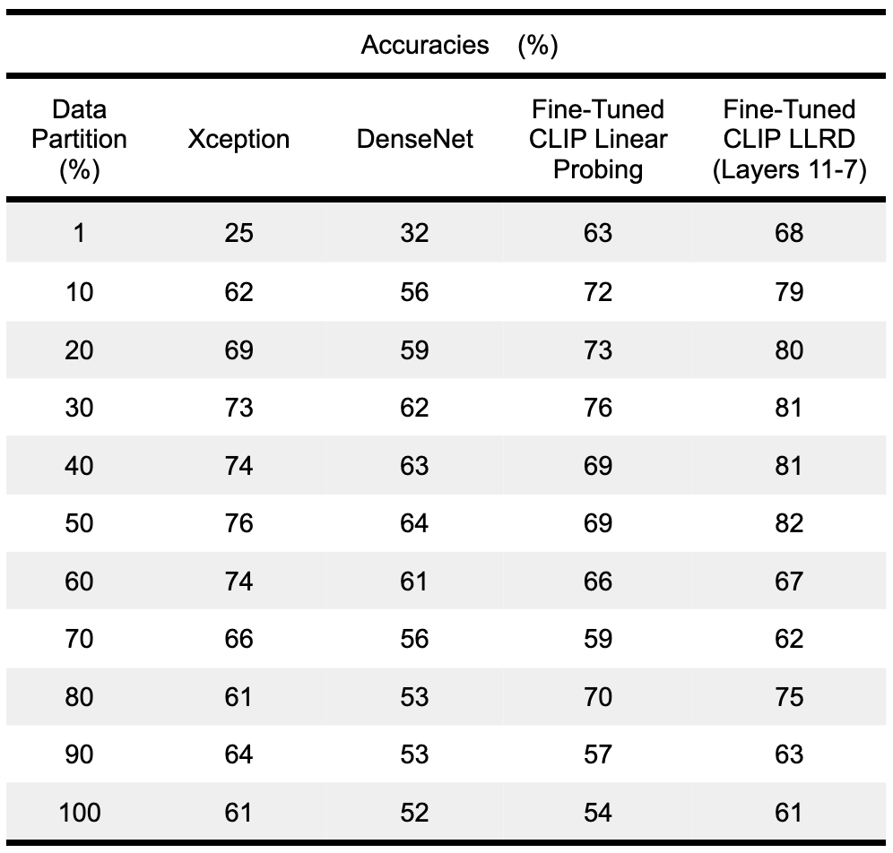
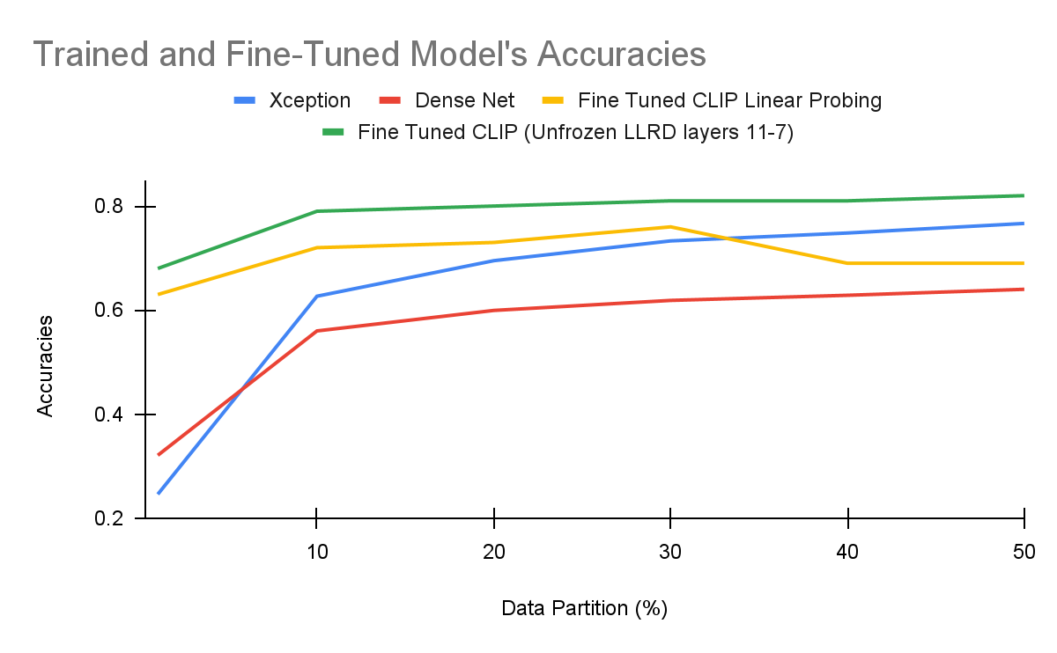
Results
Model’s Accuracies
Table 1: Accuracies of 4 models, Xception, DenseNet, Fine Tune Clip with linear probing, and Fine Tune CLIP with LLRD trained data partitions of the Food-101 dataset. Trained on SCC V100 and Google Collaborative.
Figure 1: Accuracy Curves of trained models on partitions up to 50%. The Fine-Tune CLIP LLRD model consistently outperforms the other modeles by at least 5 percent. .
Boston University EC523 Deep Learning
••••
Notes:
Aya

Slide 16
Our Fine Tuned CLIP Achieves Higher Accuracies
64%
CLIP Zeroshot
Prediction by choosing the maximum cosine similarity between text and image embeddings. Text inputs defined as “A photo of <class name>”
Analysis
62%
SOTA - Xception
Best accuracy obtained by training Google’s Xception model on 10% of Food-101 data.
79%
Our Method - Fine Tuned LLRD CLIP
Fine tuned CLIP on 10% of Food-101 data.with a learning rate decay of 0.9 and initial learning rate of 1e-3 and freezing layers 1 to 6
Boston University EC523 Deep Learning
••••
Notes:
Chris

Slide 17
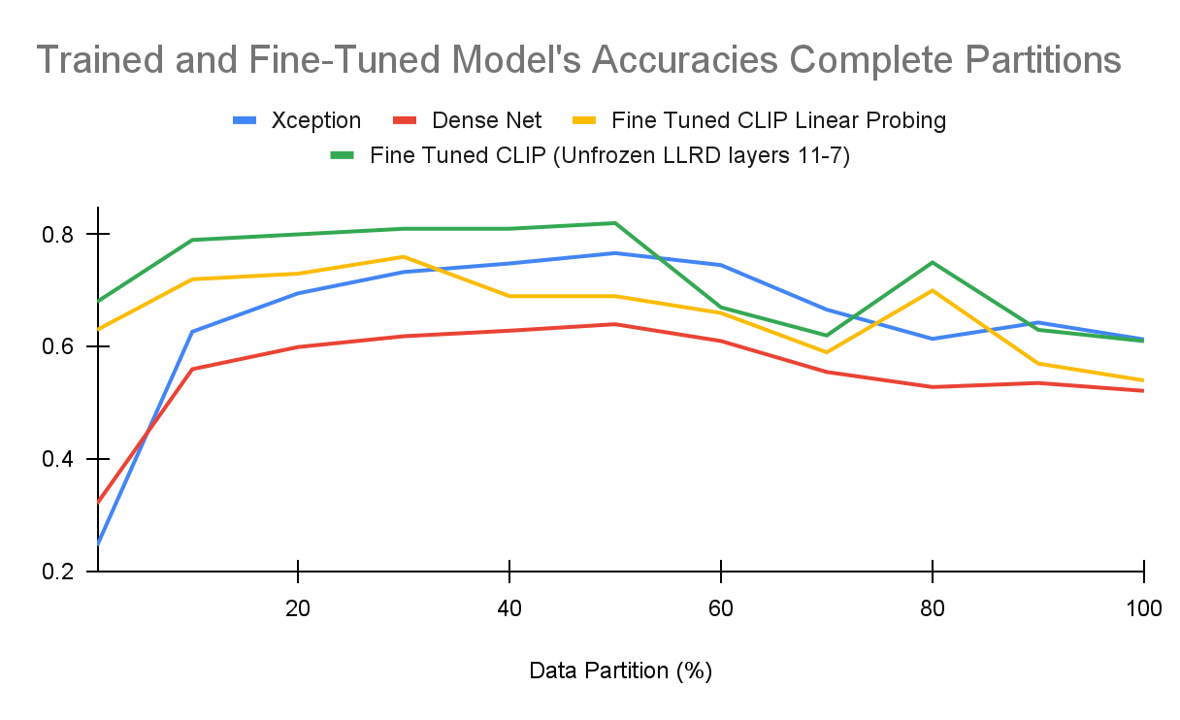

Limitations
Our Model
Analysis
Catastrophic Forgetting
More data typically means better understanding of class features
Counterintuitive, more data made the Fine-Tuned CLIP model forget its pretrained knowledge
Figure 3: Complete accuracy curves for all partitions with 60, 70, 80, 90, and 100 percent of the Food-101 dataset. Accuracy significantly decreases when trained on more than 50 percent of the data across all models.
Geometric Decay -> Other Decays?
Results showed high sensitivity to LLRD value
We want to explore possibly more sophisticated learning rate decay patterns
Boston University EC523 Deep Learning
••••
Notes:
Christian
However, our model is not perfect and has limitations like every deep learning model does. We plot the other accuracies for the data partitions past 50% of the data and we observe something interesting. Intuitively, in a classification model, the more data you train it on, the better the performance of the model should be. But we can see that the our models performance begins to plummet.

Slide 18
Limitations
Our Model
Analysis
Decreased Performance
Catastrophic Forgetting
More data typically means better understanding of class features
Counterintuitive, more data made the Fine-Tuned CLIP model forget its pretrained knowledge
Figure 3: Complete accuracy curves for all partitions with 60, 70, 80, 90, and 100 percent of the Food-101 dataset. Accuracy significantly decreases when trained on more than 50 percent of the data across all models.
Geometric Decay -> Other Decays?
Results showed high sensitivity to LLRD value
We want to explore possibly more sophisticated learning rate decay patterns
Boston University EC523 Deep Learning
••••
Notes:
Christian
All models seem to have decreased drastically when trained on more than 50% of the data. So what could we attribute this too? Its a phenomenon in fine-tuning pretrained model called catastrophic forgetting.

Slide 19
Limitations
Our Model
Analysis
Decreased Performance
Catastrophic Forgetting
More data typically means better understanding of class features
Counterintuitive, more data made the Fine-Tuned CLIP model forget its pretrained knowledge
Figure 3: Complete accuracy curves for all partitions with 60, 70, 80, 90, and 100 percent of the Food-101 dataset. Accuracy significantly decreases when trained on more than 50 percent of the data across all models.
Boston University EC523 Deep Learning
••••
Notes:
As all of these models are pretrained, when fine tuned with more data, the models begin to forget its pretrained knowledge and actually end up doing worse than CLIPs zeroshot capabilities.

Slide 20
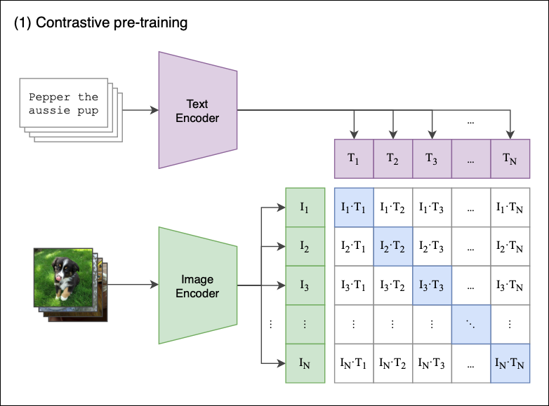
Future
Works
Analysis
01
02
Use Cosine Similarity
Various Decays
Finetune CLIP using the same loss it was pre trained on. This requires fine tuning both the image and text encoder, but may lead to more stable optimization
Arithmetic decay and compare results. Quantify forgetting.
03
04
More Sparse Data Tests
Explores Hyperparameters
Explore or create more food datasets from Google Images, social media, etc.
Fine-tune layer decays, batch size, initial learning rate, optimizers, etc.
CLIP Pretraining
Method for training the image and text encoder. Cosine similarities are maximized on the diagonal and minimized on the off diagonals.
Boston University EC523 Deep Learning
Notes:
Aya

Slide 21
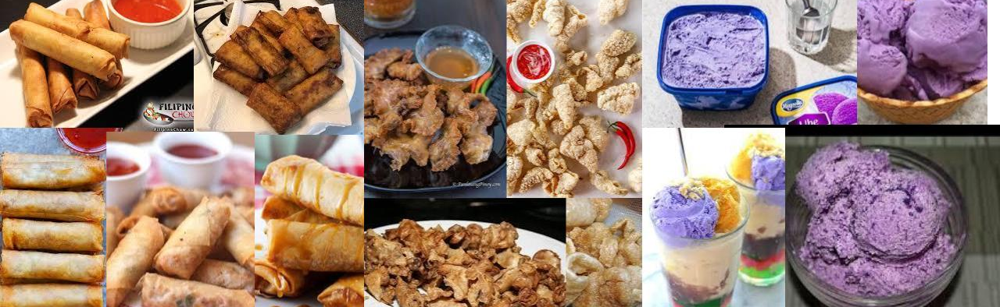
Filipino
Food
Sparse Data
92.3%
93.9%
95.1%
Zeroshot
SOTA
Our Model
CLIP Zeroshot with cosine similarity
Xception
Fine-Tuned Clip with LLRD of 0.99 and
LR of 1e-3
Lumpia, Chicharon, Ube
10 images/class
Source: Web Scraped from Google Images
Boston University EC523 Deep Learning
•••
Notes:
Lea
Quality of the images from the Google Images decreased after the first 100 images. Poor resolution or irrelevant.

Slide 22

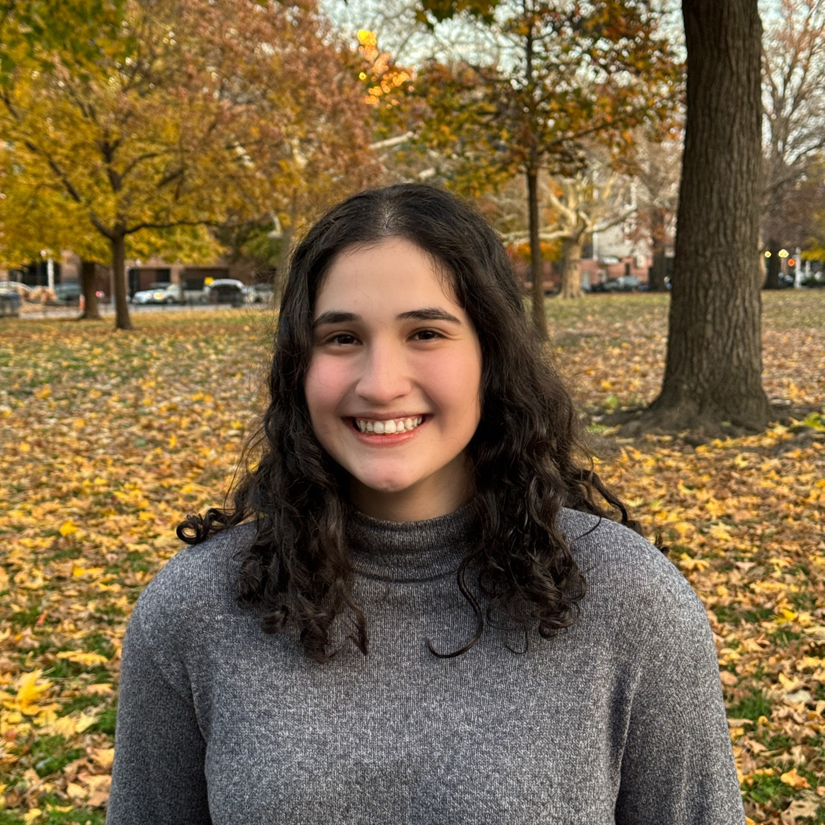
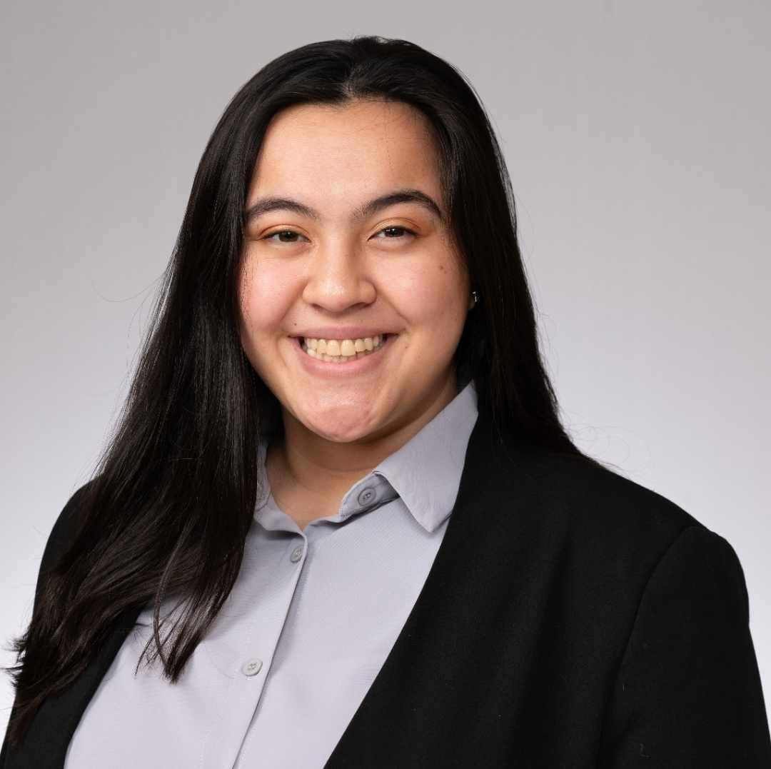

Work Distribution
The Team
We all helped with training models, analyzing results and maximizing our cumulative computational resources (SCC, Google Collab, Local). 50+ models were trained and compared.
Christopher Chan
Aya Kassem
Leanorine Lorenzana-Garcia
Christian So
Senior, CS BME
Senior, CE
Senior, CE
Junior, CE
Designed/implemented model architecture (Linear Probing, Unfreeze Layers)
Implemented Zeroshot Transfer Learning with CLIP
Researched and Implemented SOTA Models
DenseNet
XCeption
Fine-tuned SOTA Models on Food-101
Worked on Recreating Sharpness-Aware Minimization (SAM) Food-101 Benchmark
Dataset Research
Partitioned Dataset and Uploaded
Researched and Implemented SOTA Models
DenseNet
XCeption
Designed/implemented model architecture (LLRD, Layer Freezing, Zeroshot)
Developed code architecture for training/testing/evaluating
Fine-Tuned LLRD
Created web scraper for exotic foods to create data sets
Boston University EC523 Deep Learning

Slide 23
Q&A Thank you!
Christopher Chan, Aya Kassem, Leanorine Lorenzana-Garcia, and Christian So
Boston University EC523 Deep Learning
December 11, 2023

